Slide 1

React
Consuming API (2)

Slide 2
# Table of Contents
Consuming API - Detail Movie.
Refactor.

Slide 3
Consuming API

Slide 4
# Detail Page
Create Detail Page.
Figma: Link.
Page: pages/movie/Detail.js
Referensi: React - AJAX and APIs.

Slide 5
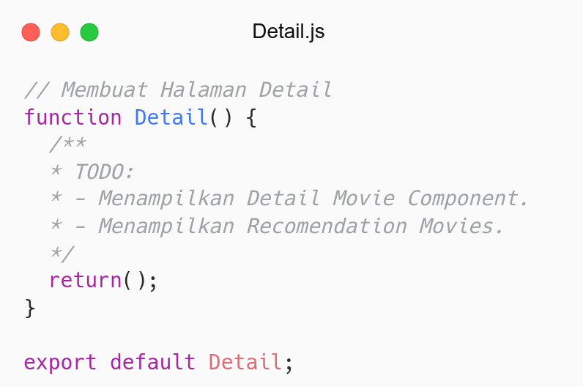
Membuat Halaman Detail.
TODO: Register to Link and Route.

Slide 6
# Detail Page Routing
Create Routing for Detail Page.
Redirect to Detail Page when Movie is clicked.
Add Link to each Movie.
Link: /movie/{id}.
Route: /movie/:id.
Referensi: React Router - URL Params.

Slide 7
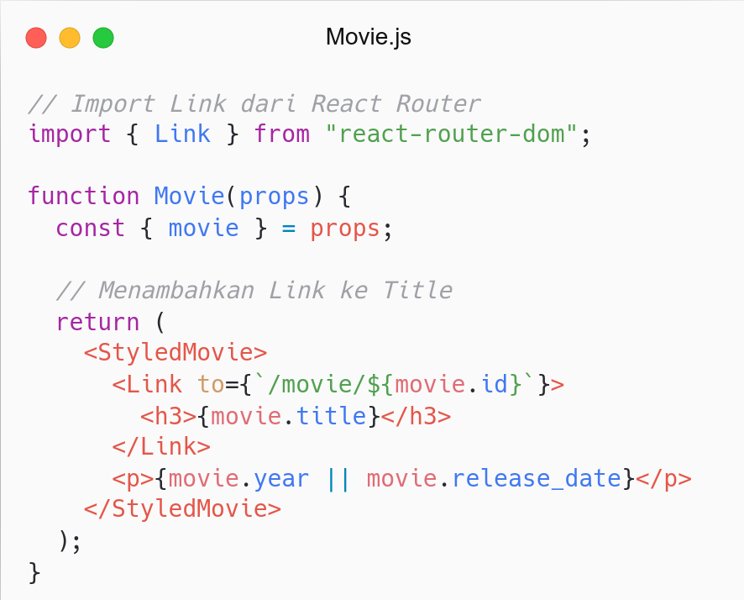
Add Link to Movie.
Link wrap movie title.
Redirect to Detail page.

Slide 8
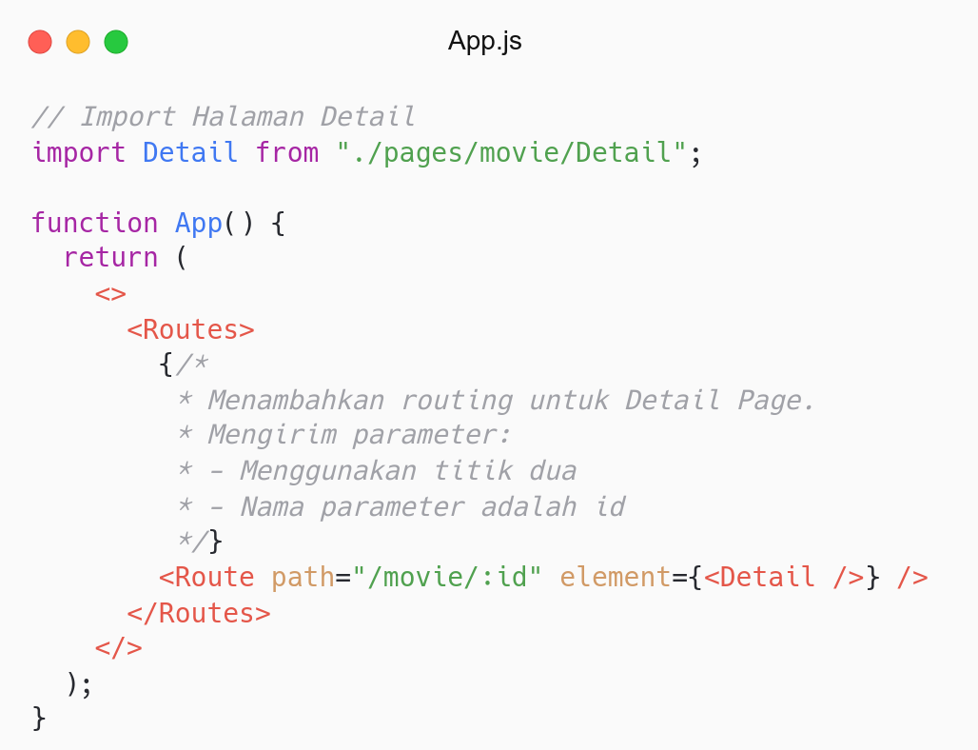
Create Routing for Detail Movie.
Routing menerima parameter: id.
Nilai parameter disimpan di variable id.

Slide 9
# Detail Movie
Create Detail Movie Component.
Component: components/DetailMovie/index.js
Endpoint: /movie/{id}.
Referensi: React - AJAX and APIs.

Slide 10
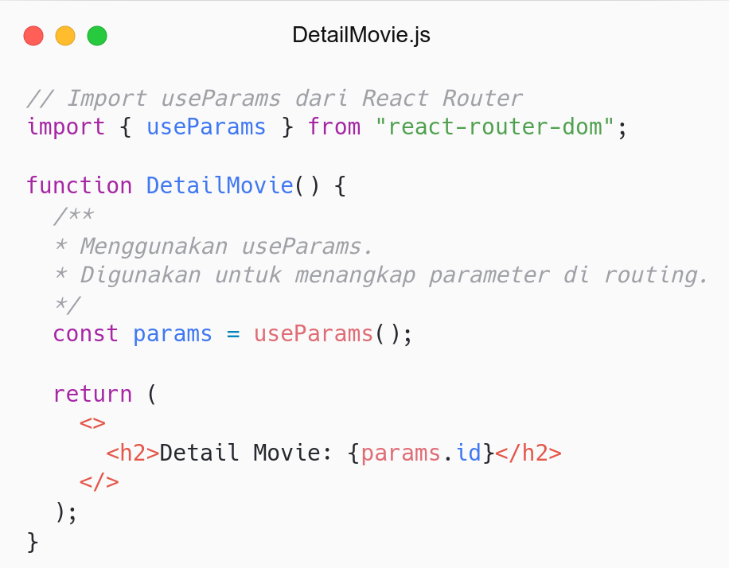
Menangkap parameter id di routing: /movie/:id.
Menggunakan useParams.
Use DetailMovie at Detail Page.
TODO: Fetch Detail Movie by ID from TMDB.

Slide 11
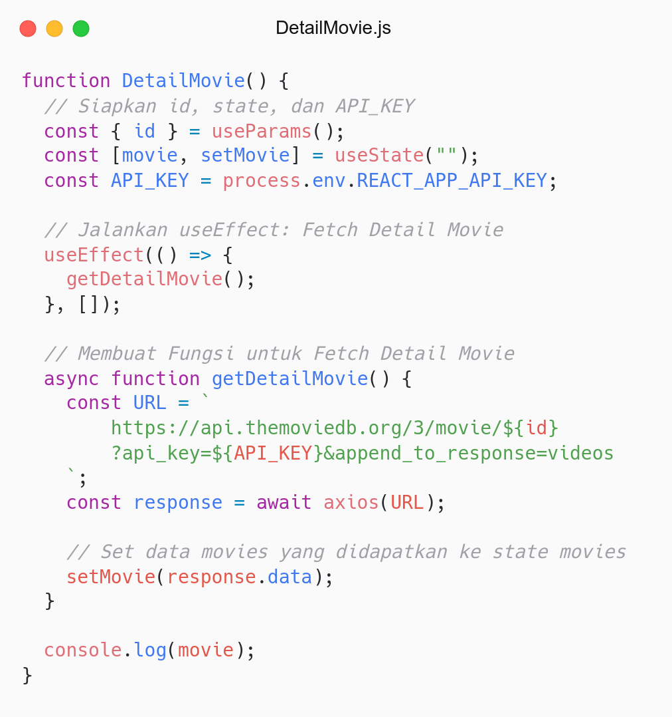
Melakukan Fetch Detail Movie by ID.
TODO: Render to JSX.

Slide 12
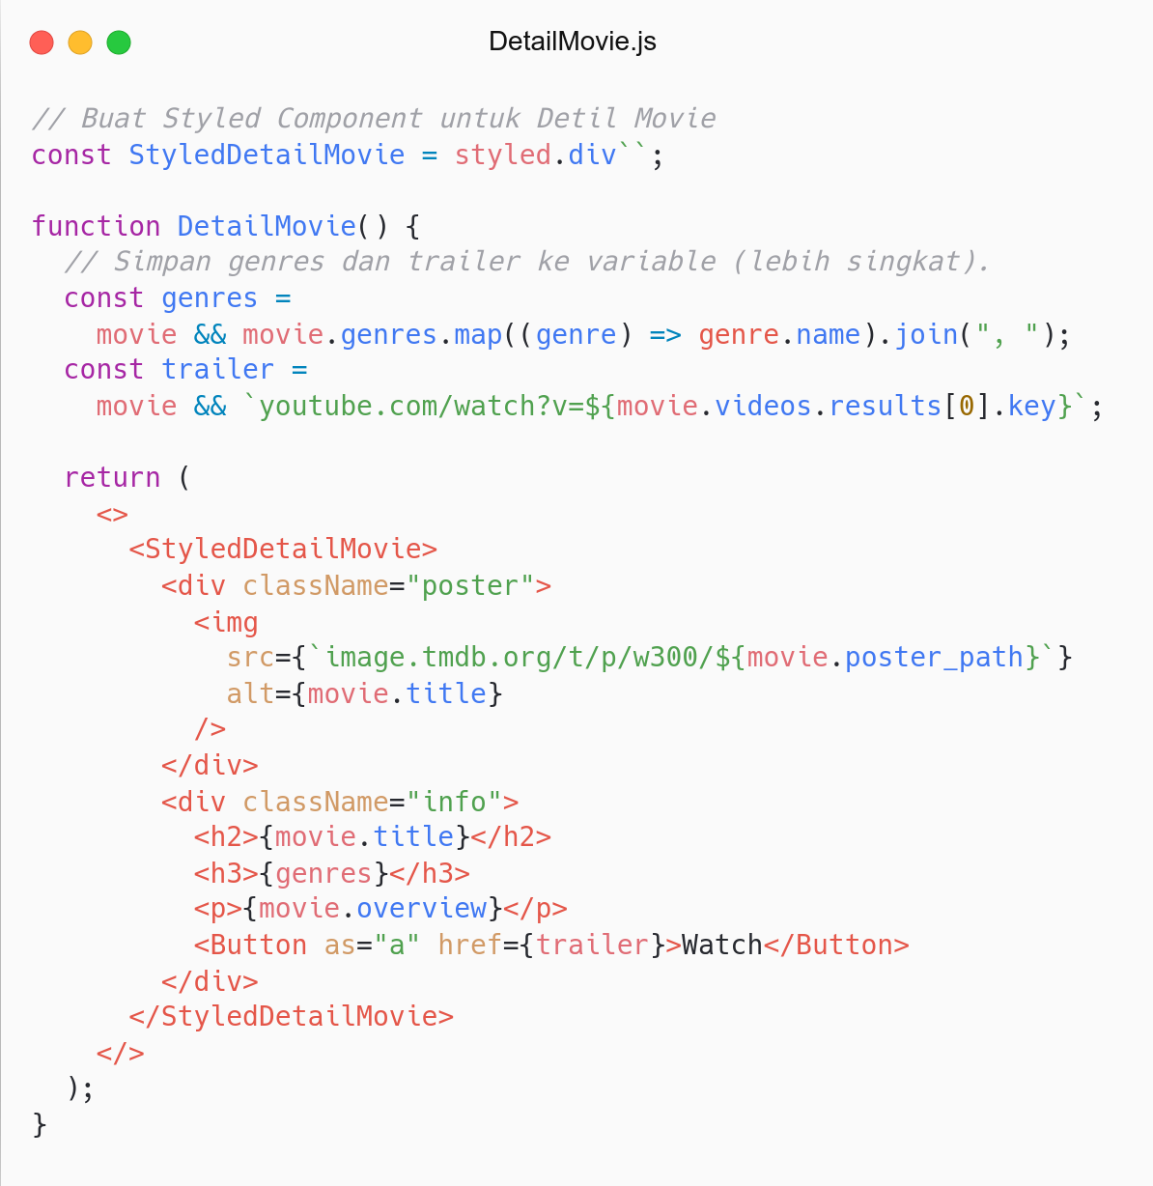
Buat Styled Component untuk Detail Movie.
Simpan genres dan trailer ke variable.
Render movie ke JSX.
TODO: Styling Detail Movie.

Slide 13
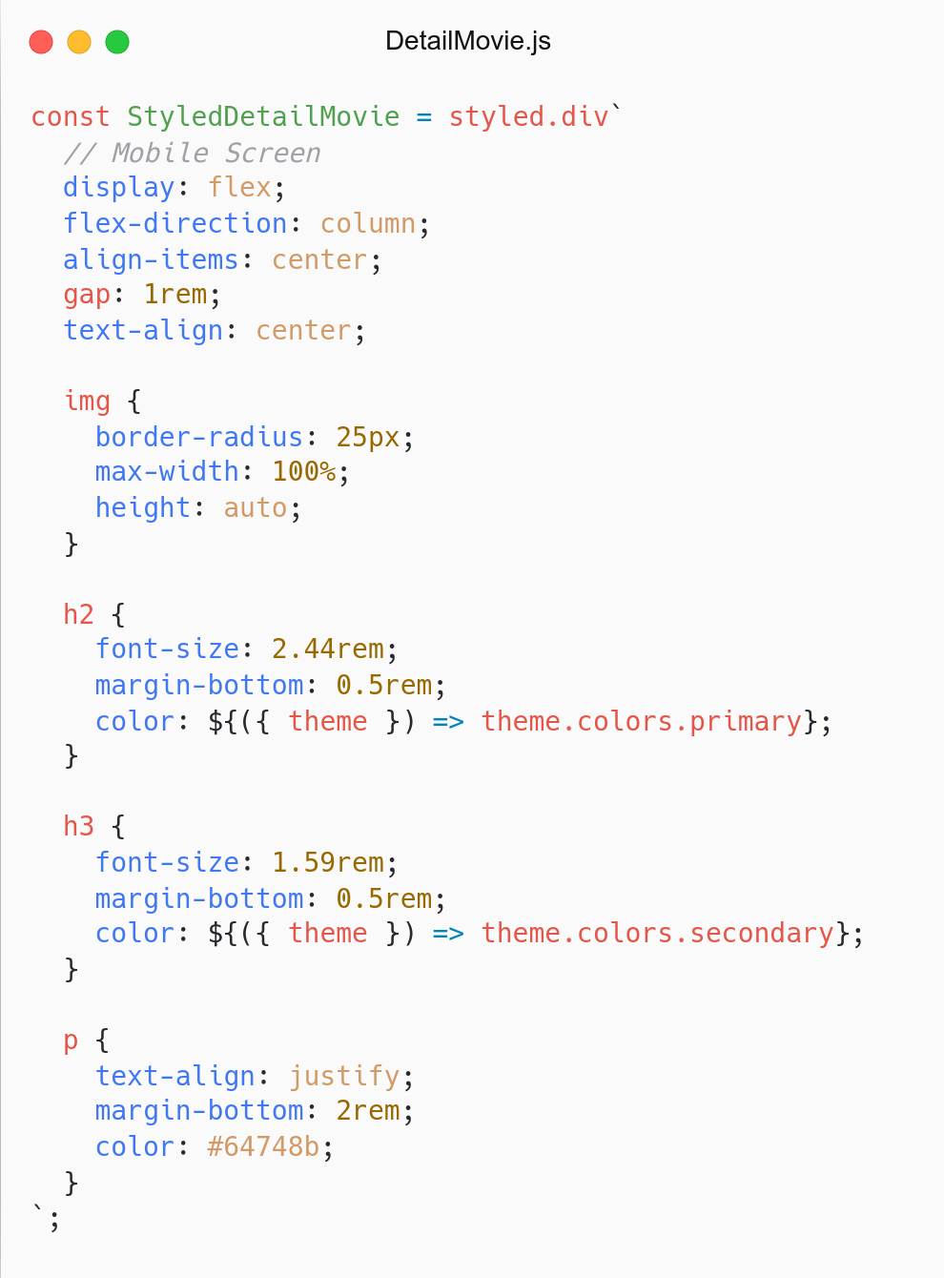
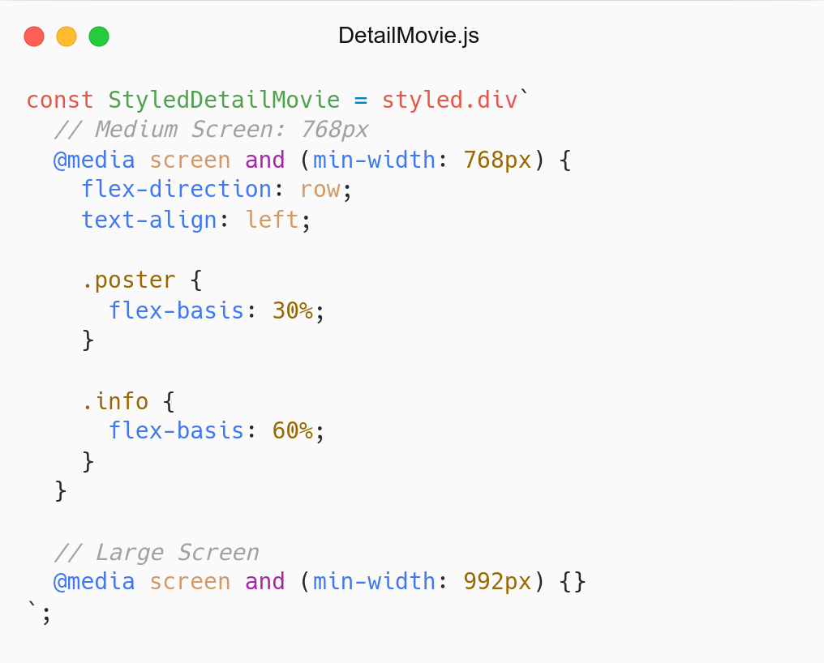
Add Style for Detail Movie.
Mobile first approach.
Grab CSS from Github.
Refactor: Separate Styled Component

Slide 14
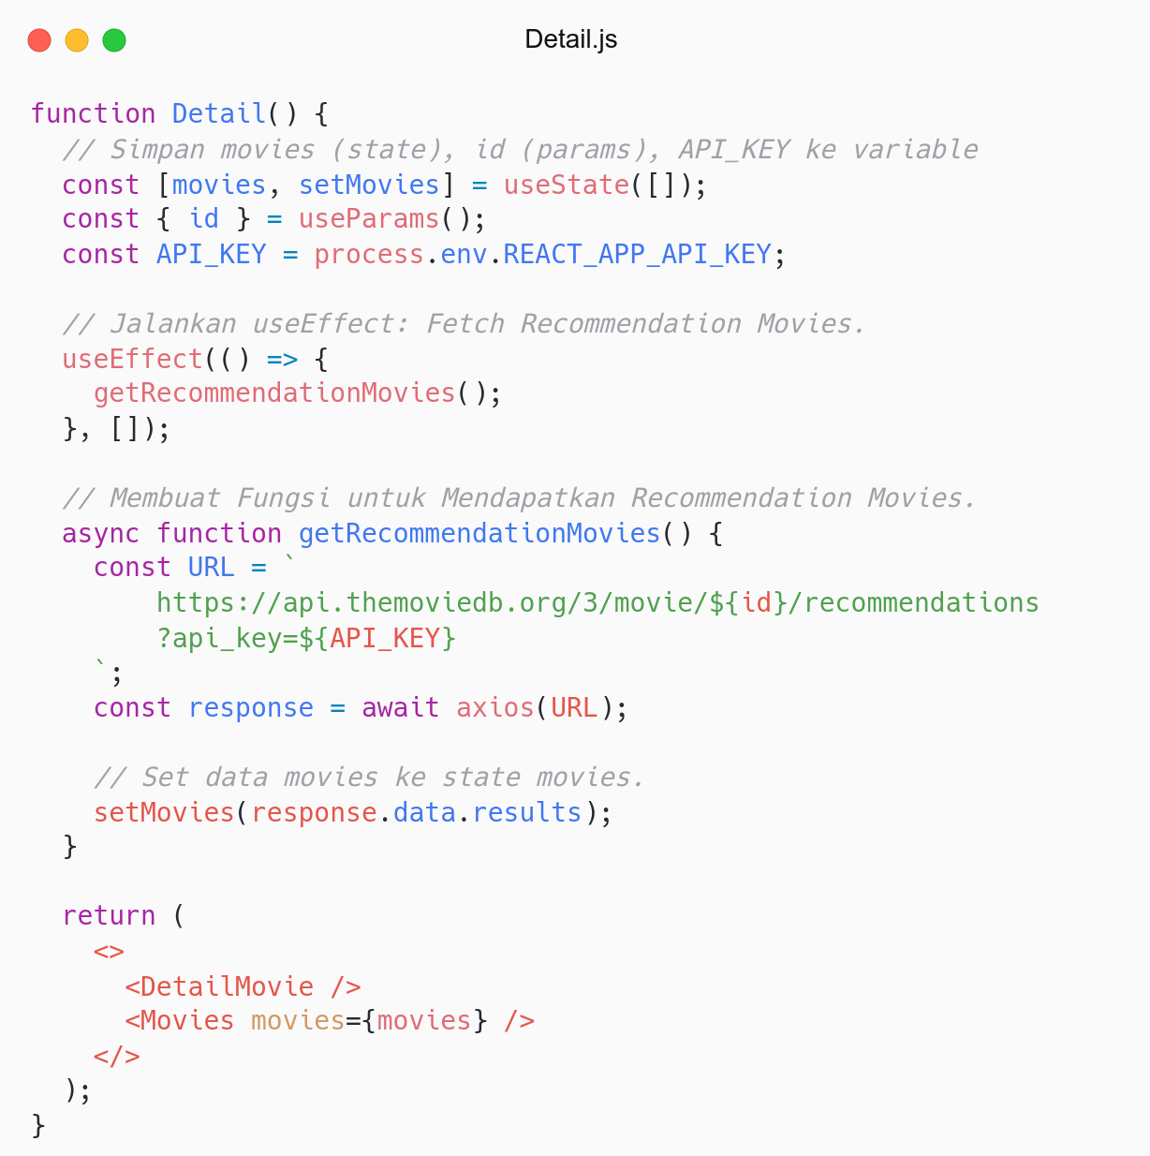
Fetch Recommendation Movies.
Render movies to Movies Component.
Nice.

Slide 15
# BUG
Unexpected problem in App.
Go to Detail Page. Access another movie from Detail Page.
Detail Movie: Not re-rendered when id changes.
Recommendation Movies: Not re-rendered when id changes.
How to solve?

Slide 16
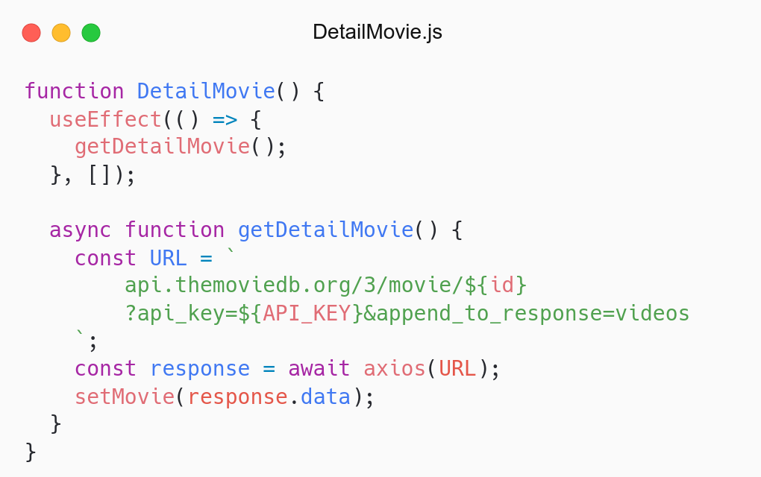
Focus at useEffect.
Explain how it works? and why?
Try to think about Lifecycle.
Remember? or Not?

Slide 17
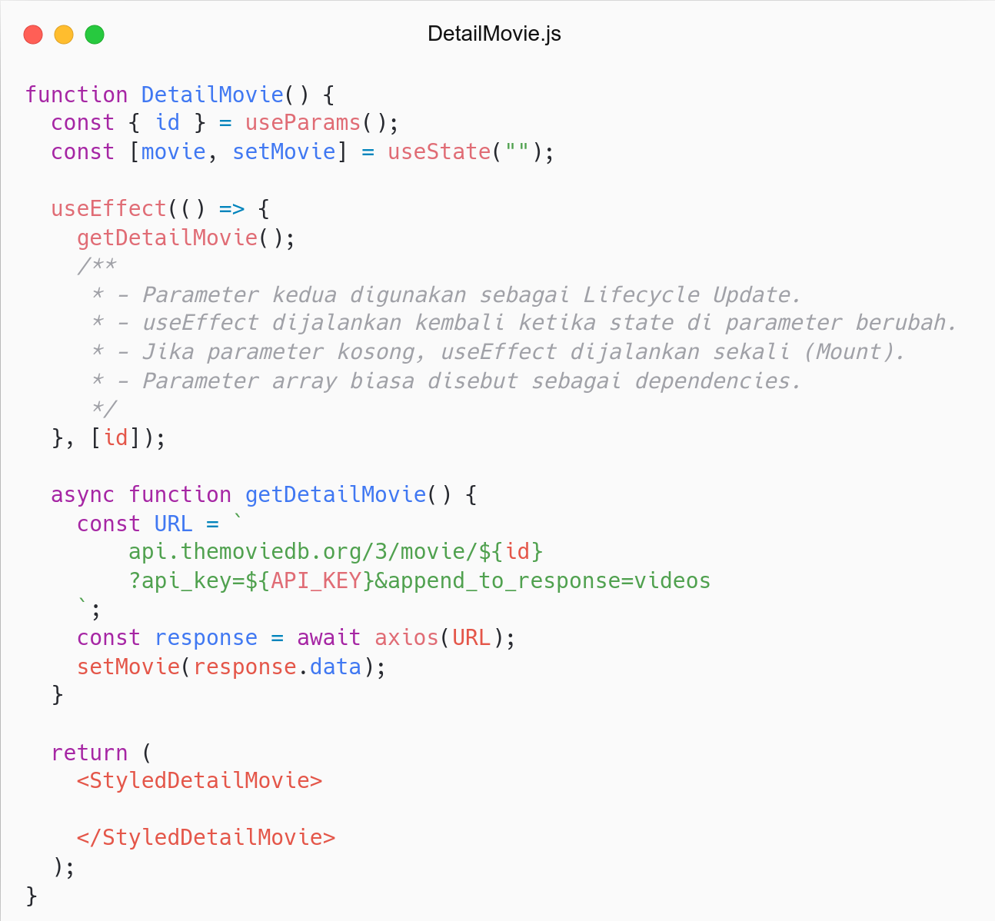
Add id state in second params.
useEffect dijalankan kembali ketika state di params berubah.
Params kedua digunakan sebagai Lifecycle Update.
Try it again, Is it work?
Now, Try to debug Recommendation Movies.

Slide 18
Refactor

Slide 19
# Refactor
Create constant Endpoints.
Add title props in Movies.

Slide 20
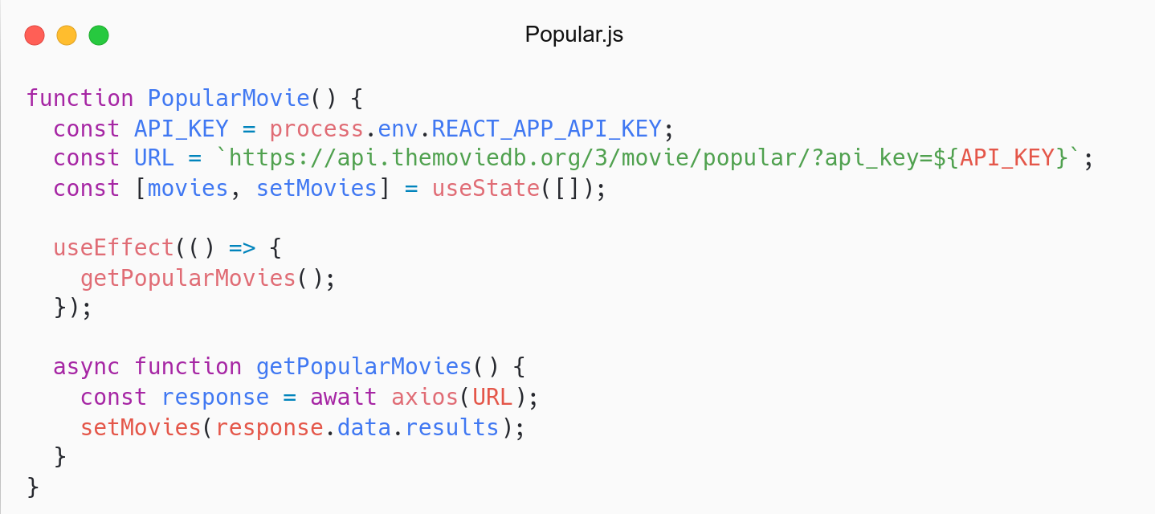
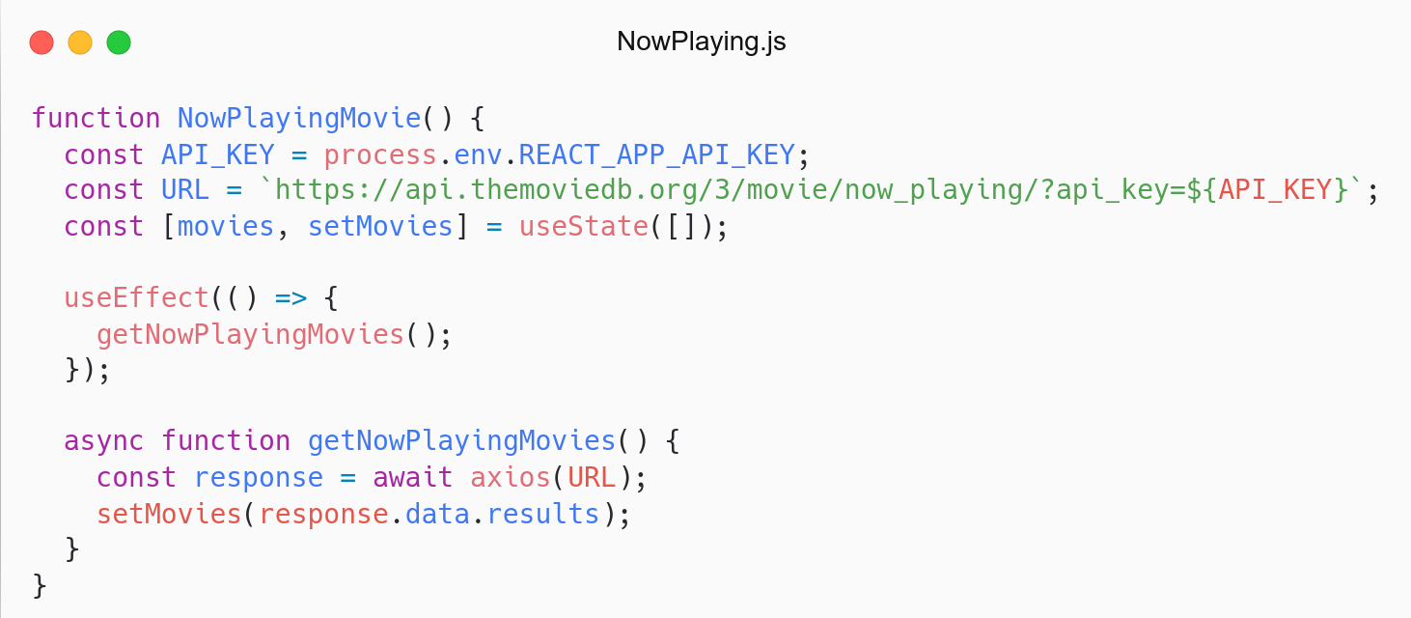
Apakah ada kode yang berulang?
API_KEY, Endpoint.
Fetch data (useEffect).
Solution:
Create constant Endpoints.
Create custom hook.

Slide 21
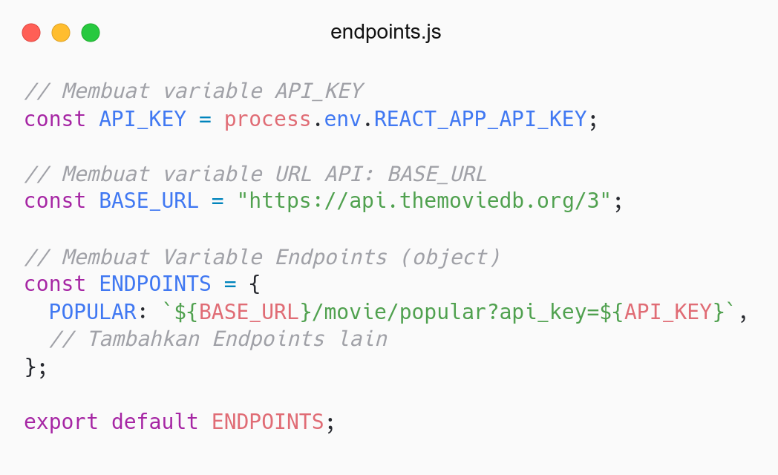
Membuat file endpoints.
Untuk menyimpan endpoint movie.
endpoints: utils/constants/endpoints.js.

Slide 22
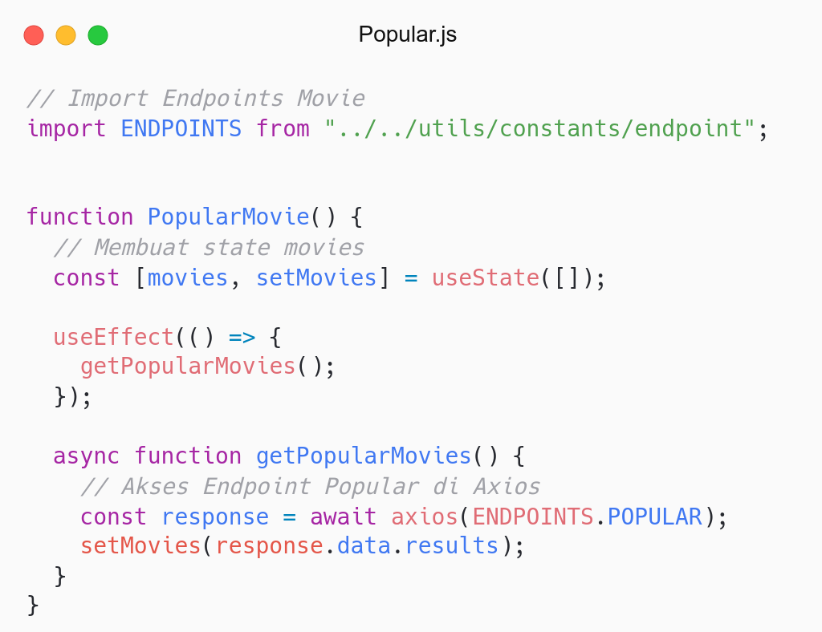
Import Endpoints Movie.
Gunakan Endpoints Popular di Axios.
Tidak butuh API_KEY dan URL.

Slide 23
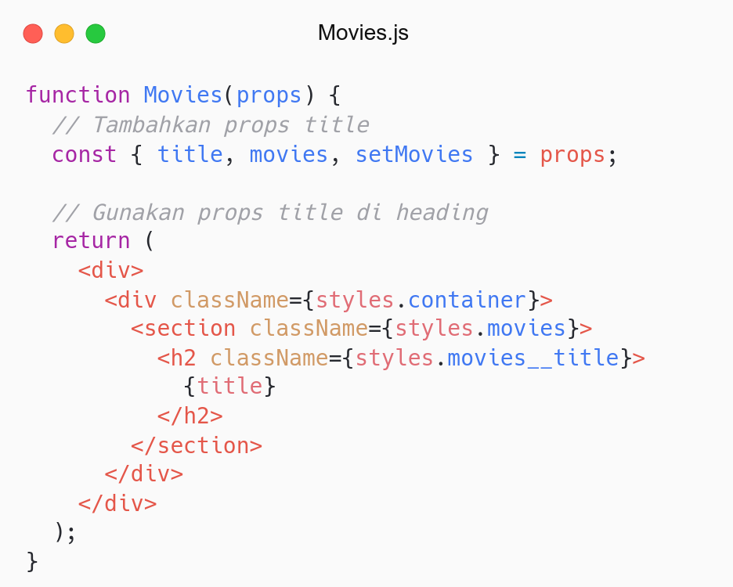
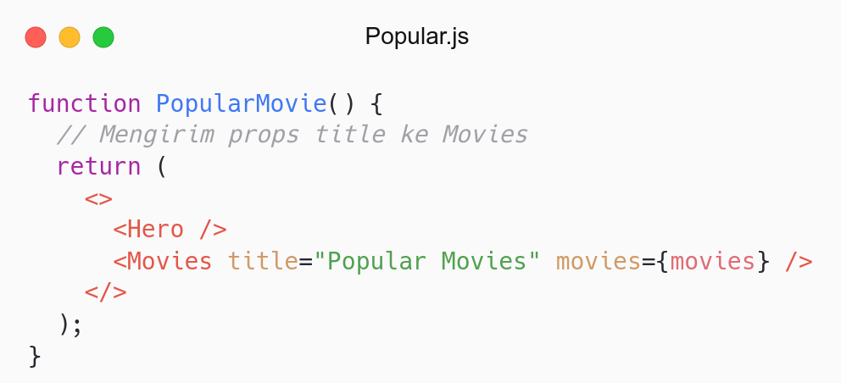

Slide 24
QnA

Slide 25
Take Away

Slide 26
# TODO
Create others endpoints:
Endpoints: Now Playing, Top Rated, Detail, Recommendation, Hero
Use that endpoints in each page.
Send title props to Movies from every page.

Slide 27
# Assignment
Push code to Repository Github (use branch for task management).
No zip and don’t push node_nodules folder.
Submit link repository to elena.
Kamis: 09 Juni 2022, Link Elena.
Jumat: 11 Juni 2022, Link Elena.

Slide 28
Attendance

Slide 29
Thanks

